Slide 1
Triplet Network for Few Shot Learning
By:
Daniel Teitelman
Gonen Wiess

Slide 2
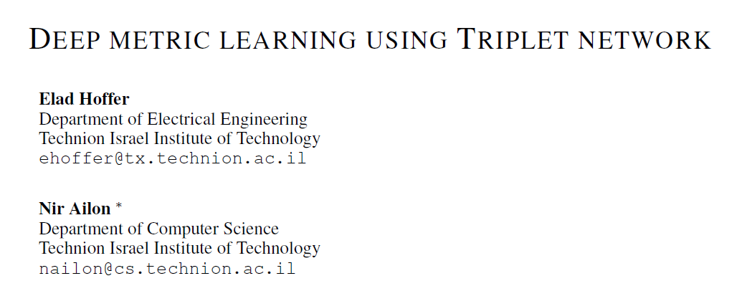
The goal of our work
Reimplement the paper "Deep Metric Learning Using Triplet Network" by Elad Hoffer et al.
Apply the method on the Fashion-MNIST dataset.
Use the learned metric by the triplet network for few shot learning.

Slide 3
Fashion MNIST
Training set of 60K examples.
Test set of 10K samples.
A Harder dataset the MNIST.
Not used in Elad Hoffer et al paper.

Slide 4
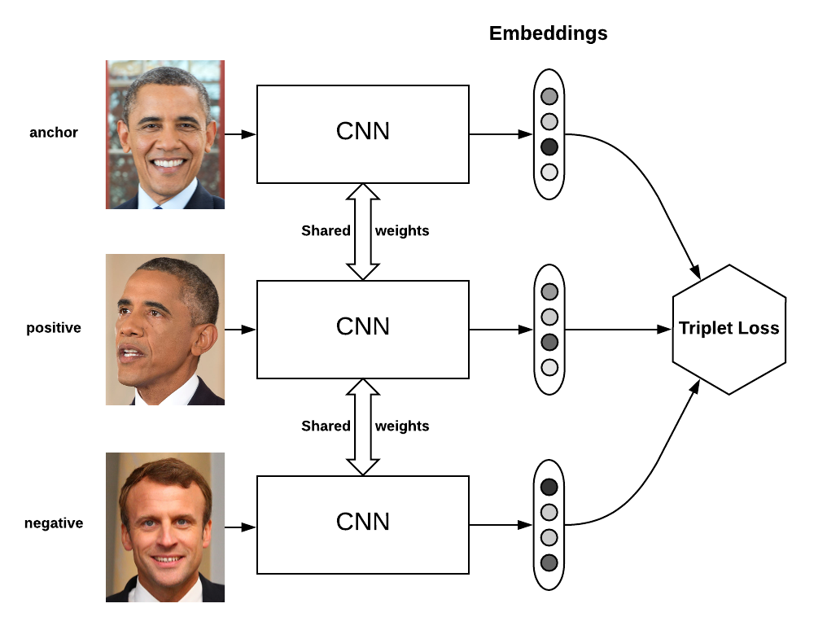
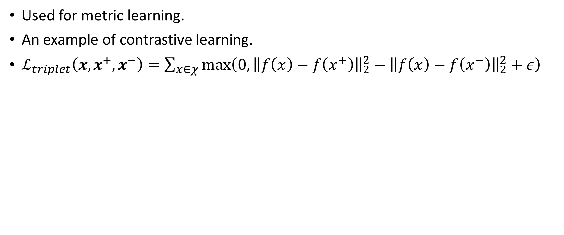
Triplet network
Used for metric learning.
An example of contrastive learning.
$ℒ_{triplet}\left(x,x^{+},x^{−}\right)=\sum_{x∈χ}{\max\left(0,{\left\|f\left(x\right)−f\left(x^{+}\right)\right\|}_{2}^{2}−{\left\|f\left(x\right)−f\left(x^{−}\right)\right\|}_{2}^{2}+ε\right)}$

Slide 5
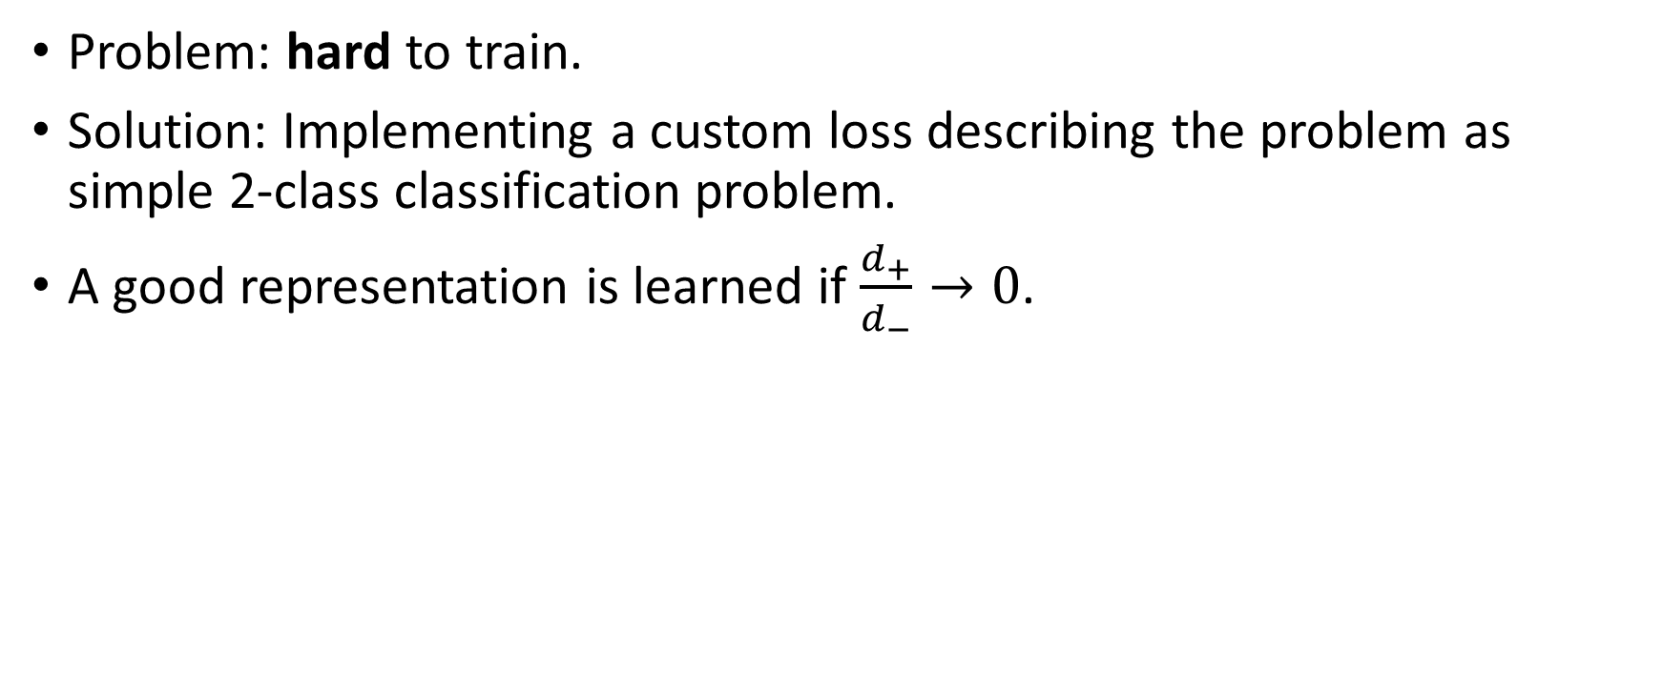
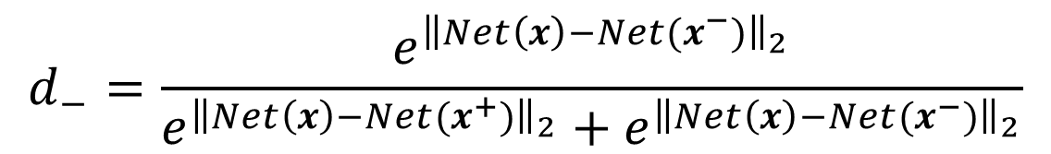
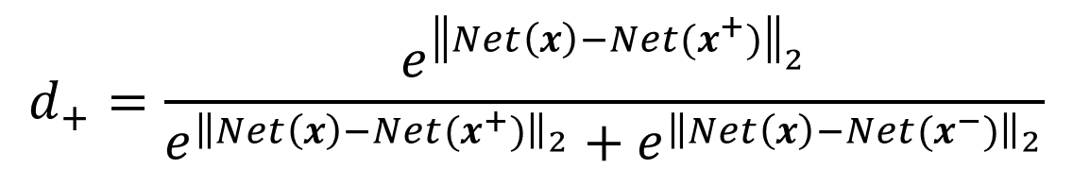
Rethinking the triplet loss
Problem: hard to train.
Solution: Implementing a custom loss describing the problem as simple 2-class classification problem.
A good representation is learned if $\frac{d_{+}}{d_{−}}→0$.
$$Loss\left(d_{+},d_{−}\right)={\left\|\left(d_{+},d_{−}−margin\right)\right\|}_{2}^{2}$$
$$d_{+}=\frac{e^{{\left\|Net\left(x\right)−Net(x^{+})\right\|}_{2}}}{e^{{\left\|Net\left(x\right)−Net(x^{+})\right\|}_{2}}+e^{{\left\|Net\left(x\right)−Net(x^{−})\right\|}_{2}}}$$
$$d_{−}=\frac{e^{{\left\|Net\left(x\right)−Net(x^{−})\right\|}_{2}}}{e^{{\left\|Net\left(x\right)−Net(x^{+})\right\|}_{2}}+e^{{\left\|Net\left(x\right)−Net(x^{−})\right\|}_{2}}}$$

Slide 6
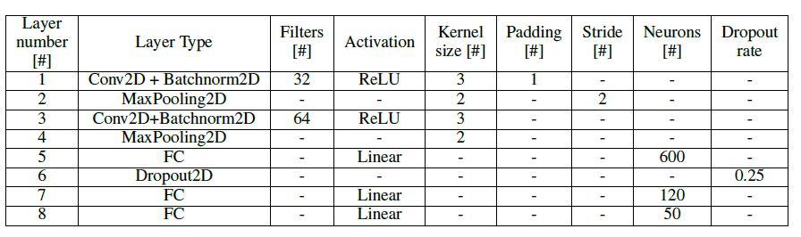
Network architecture

Slide 7
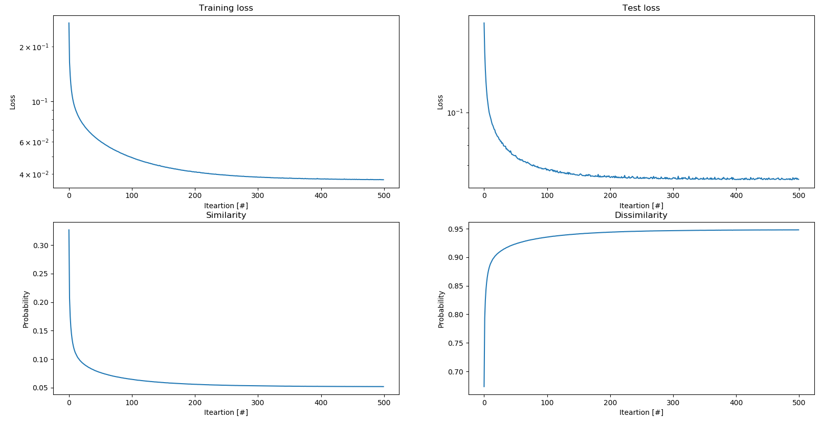
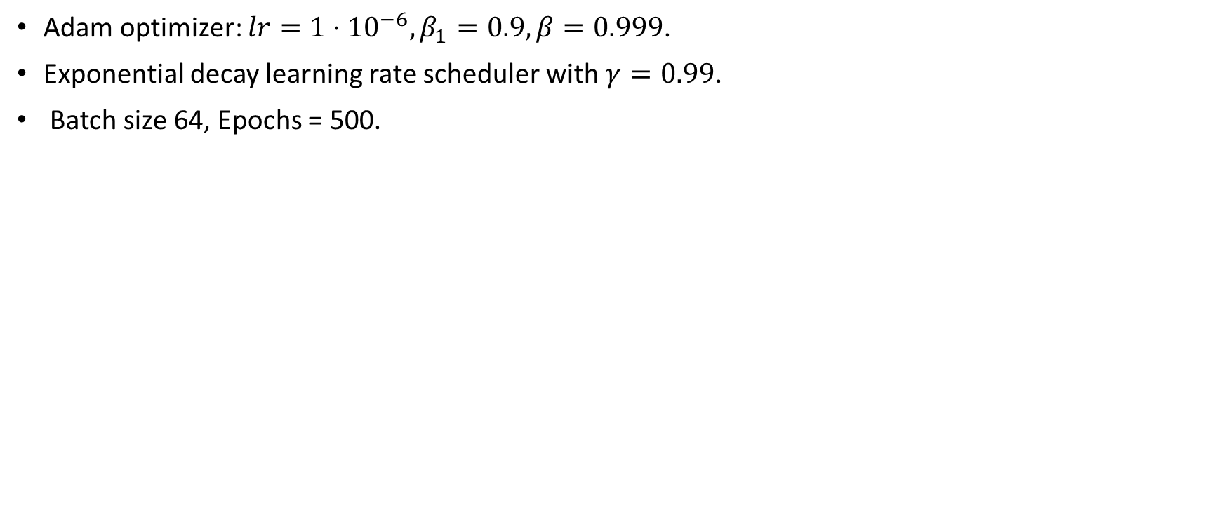
Training the triplet network
Adam optimizer: $lr={1⋅10}^{−6}, β_{1}=0.9, β=0.999$.
Exponential decay learning rate scheduler with $γ=0.99$.
Batch size 64, Epochs = 500.

Slide 8
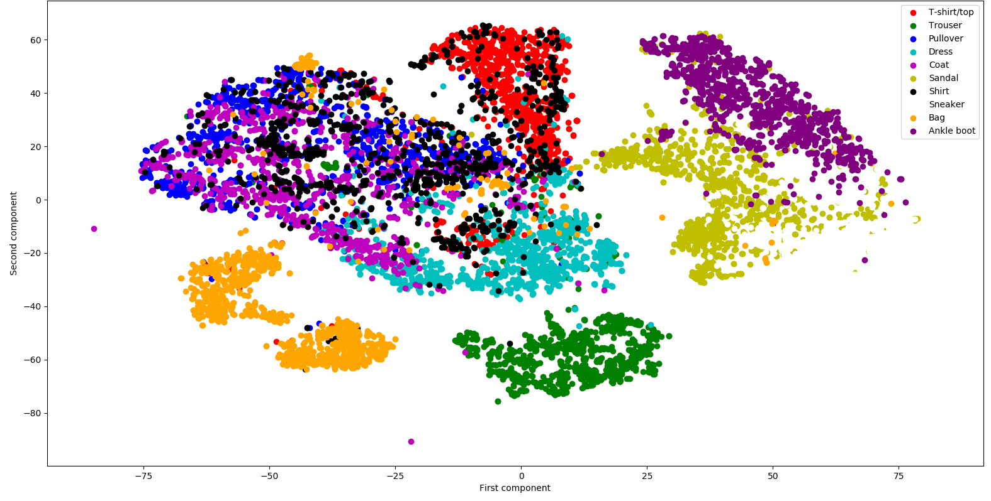
T-SNE of original dataset

Slide 9
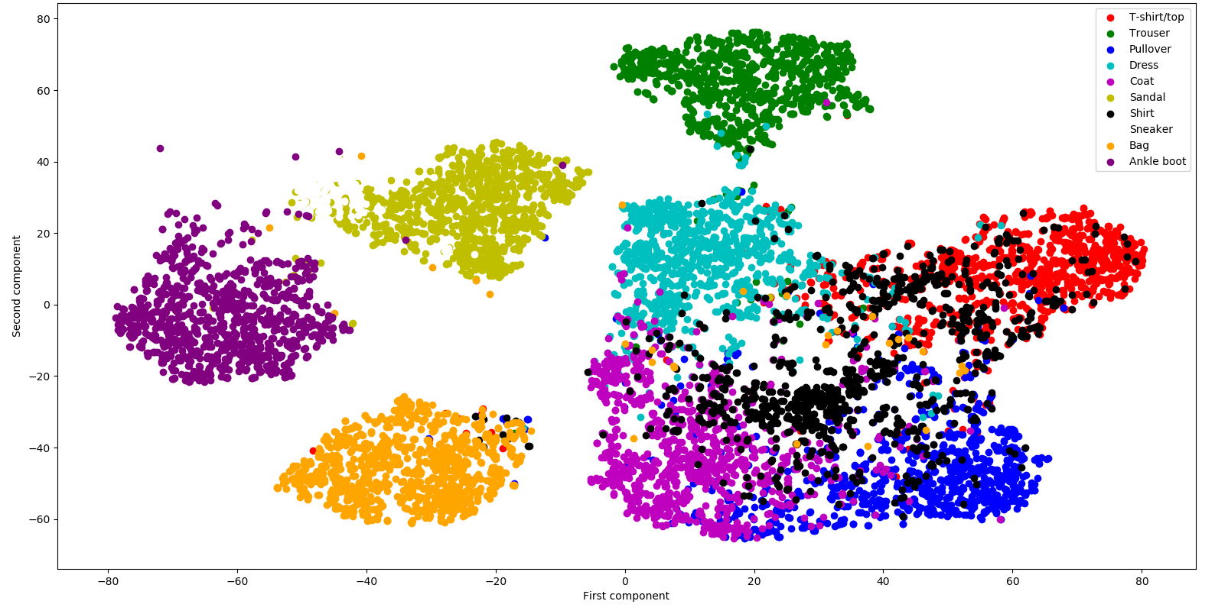
T-SNE of feature vectors

Slide 10
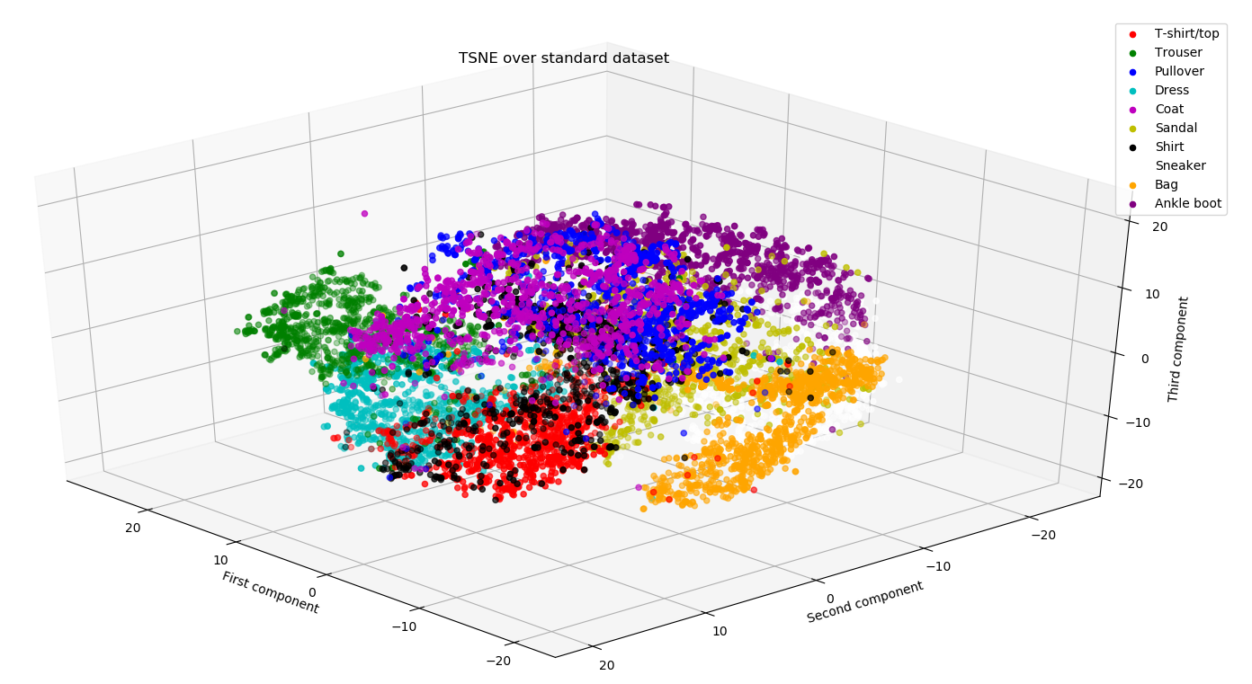
T-SNE of original dataset

Slide 11
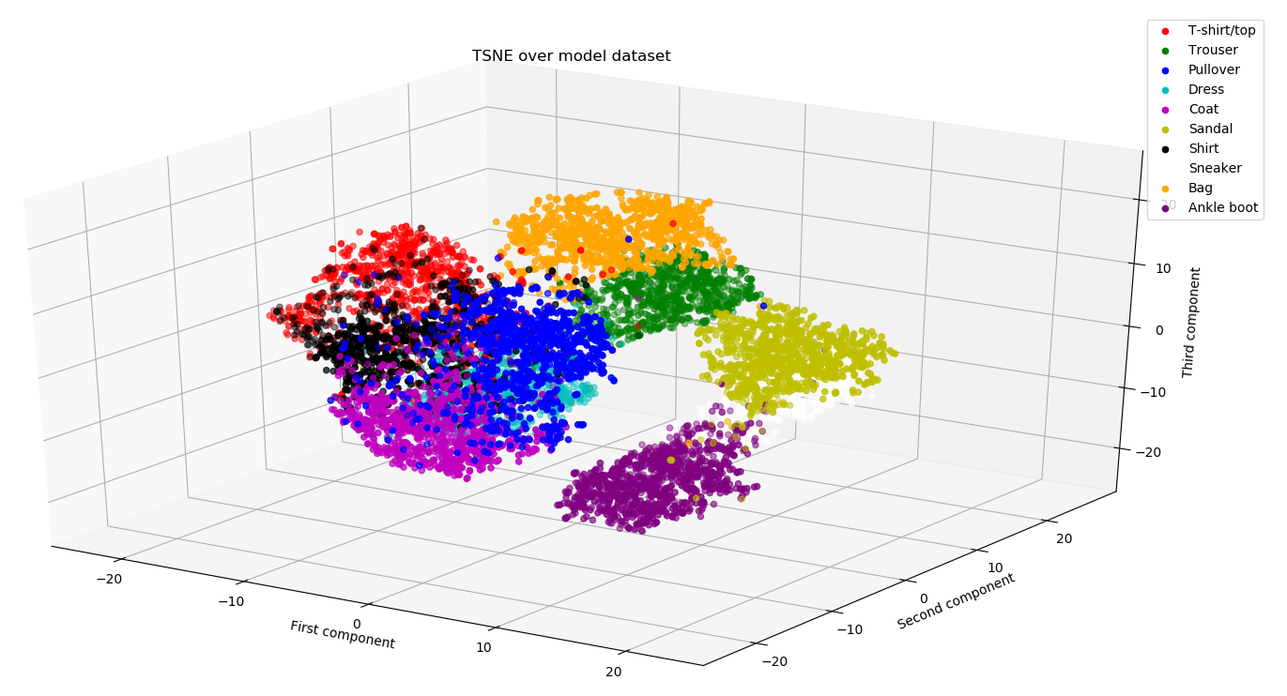
T-SNE of feature vectors

Slide 12
Comparing linear classifiers to DNNs
Accuracy (test set) | Input type | Model
91.01% | Raw images | DNN
88.41% | Embedded vector | Linear SVM
88.16% | Embedded vector | KNN (n=100)

Slide 13
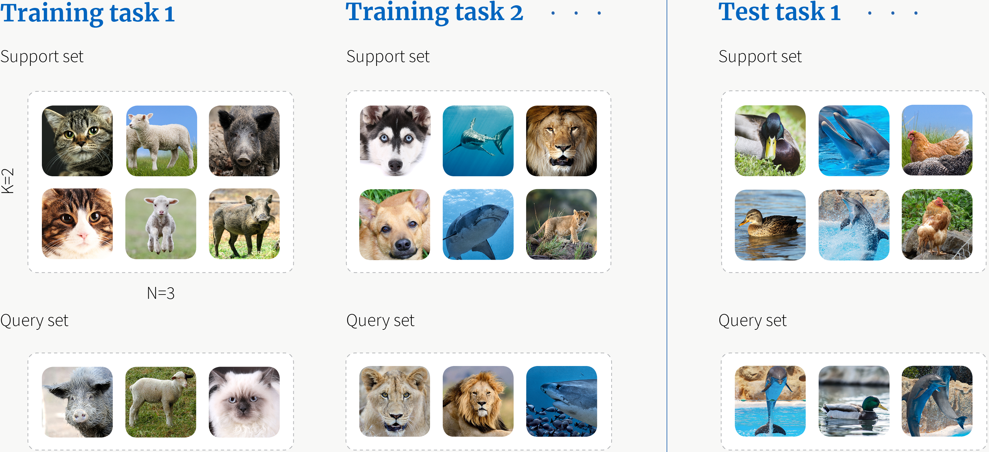
Few-shot learning – a short introduction
A type of machine learning problem where the training dataset contains limited information.
Evaluation of few shot learning models is done using a support and query set defined by two parameters: N-way-K-shot.

Slide 14
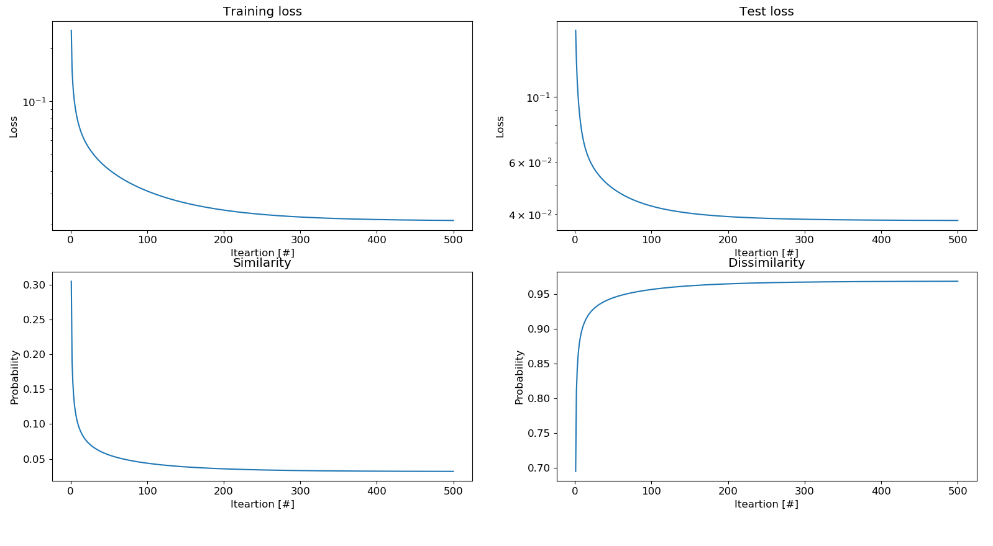
Training

Slide 15
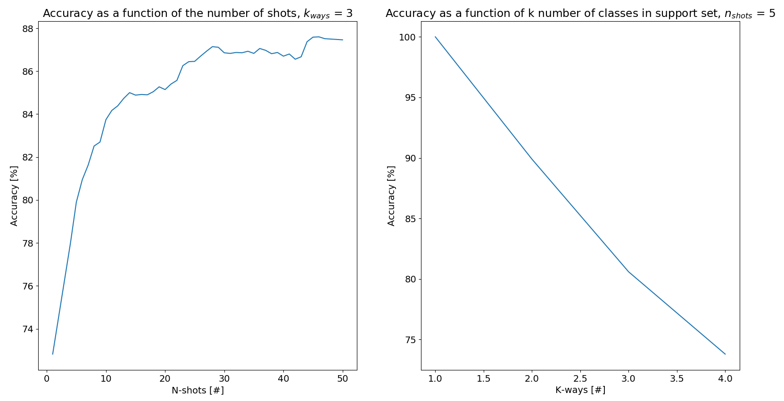
Results
More shots (examples) higher accuracy.
More ways (classes) Lower accuracy

Slide 16
Conclusion
We reimplemented the "Deep Metric Learning Using Triplet Network" in modern PyTorch.
Evaluated the idea on an untested dataset.
Demonstrated the use triplet network for few-shot learning.

Slide 17
Questions?

